Slide 1

Algebra 1
Unit 6, Lesson 2 Solving Compound Inequalities Volume 1, pg. 297

Slide 2


Benchmark
MA.912.AR.2.6
Given a mathematical or real-world context, write and solve one-variable linear inequalities, including compound inequalities. Represent solutions algebraically or graphically.
volume 1, pg. 297

Slide 3
Integrated Mathematical Thinking and Reasoning Standards
MA.K12.MTR.1.1 Actively participate in effortful learning both individually and collectively.
MA.K12.MTR.2.1 Demonstrate understanding by representing problems in multiple ways.
MA.K12.MTR.3.1 Complete tasks with mathematical fluency.
MA.K12.MTR.4.1 Engage in discussions that reflect on the mathematical thinking of self and others.
MA.K12.MTR.5.1 Use patterns and structure to help understand and connect mathematical concepts.
MA.K12.MTR.6.1 Assess the reasonableness of solutions.
MA.K12.MTR.7.1 Apply mathematics to real-world contexts.
volume 1, pg. 297

Slide 4

Learning Targets
I can solve compound one-variable inequalities.
I can graph the solution of an inequality on a number line.
I can interpret solutions to problems as viable or non-viable options.
volume 1, pg. 297

Slide 5

Warm-Up
volume 1, pg. 298

Slide 6
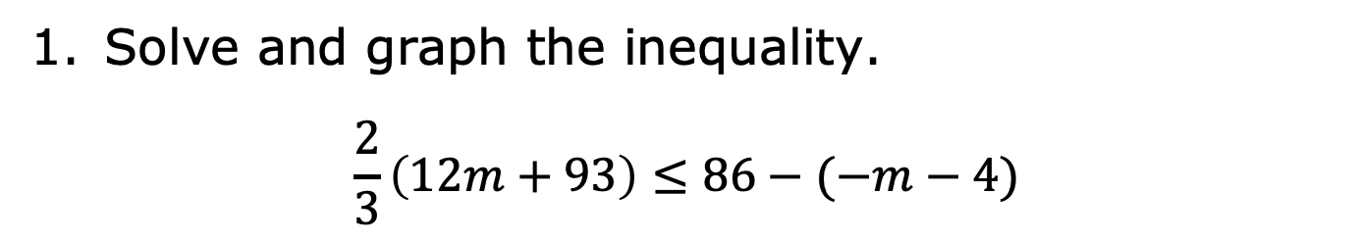
6.2.1 Warm-Up: Bell Work
Solve and graph the inequality.
$$\frac{2}{3}\left(12m+93\right)≤86−(−m−4)$$
volume 1, pg. 298

Slide 7

Exploration
volume 1, pg. 298

Slide 8

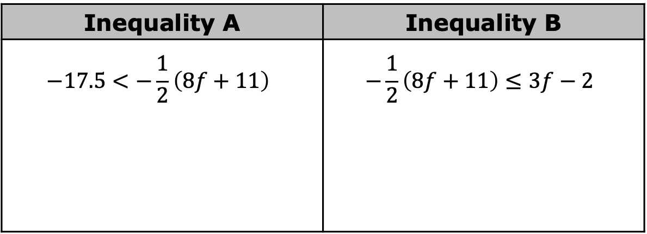
6.2.2 Exploration: Is It a Solution?
Two inequalities are shown in the table.
With your partner, discuss the similarities and differences of the two inequalities. Summarize your discussion.
Solve each of the inequalities in the space provided in the table.
Inequality A | Inequality B
$$−17.5<−\frac{1}{2}\left(8f+11\right)$$ | $$−\frac{1}{2}\left(8f+11\right)≤3f−2$$
volume 1, pg. 298

Slide 9
Graph the solution set of Inequality A.
Graph the solution set of Inequality B.
volume 1, pg. 298

Slide 10
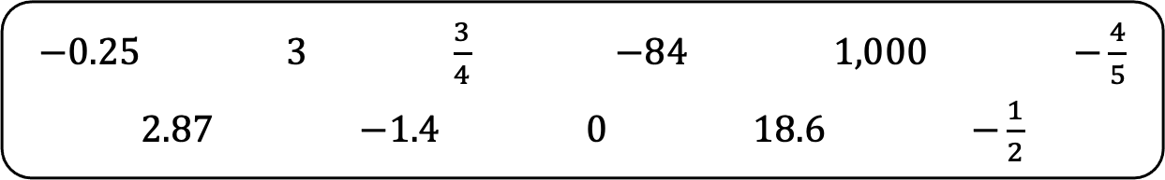
A list of values is shown.
With your partner, determine whether each value is in the solution set of Inequality A only, Inequality B only, or both. Record the values in the table below.
$−0.25$ $3$ $\frac{3}{4}$ $−84$ $1,000$ $−\frac{4}{5}$
$2.87$ $−1.4$ $0$ $18.6$ $−\frac{1}{2}$
Solution to Inequality A Only | Satisfies Both Inequalities | Solution to Inequality B Only
volume 1, pg. 299

Slide 11
Write two more numbers that are solutions to both Inequality A and Inequality B.
Describe the set of numbers that satisfies both Inequality A and Inequality B.
volume 1, pg. 299

Slide 12

Guided Instruction
volume 1, pg. 299

Slide 13

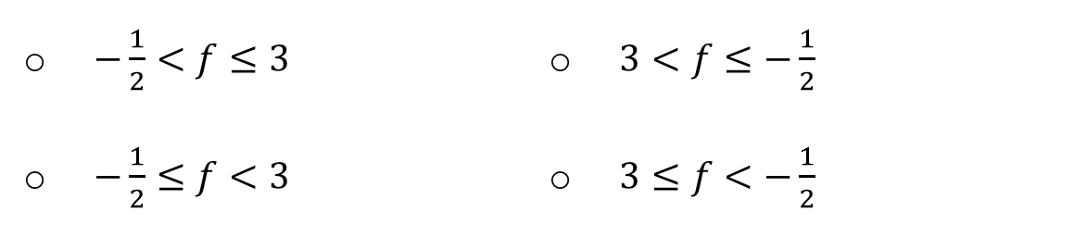
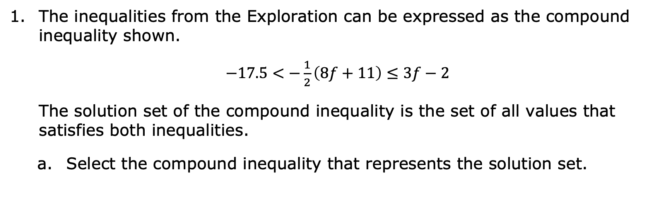
6.2.3 Guided Instruction: Compound Inequalities
A compound inequality is a conjunction of two or more inequalities.
The inequalities from the Exploration can be expressed as the compound inequality shown.
$−17.5<−\frac{1}{2}\left(8f+11\right)≤3f−2$
The solution set of the compound inequality is the set of all values that satisfies both inequalities.
Select the compound inequality that represents the solution set.
$−\frac{1}{2}<f≤3$
$−\frac{1}{2}≤f<3$
$3<f≤−\frac{1}{2}$
$3≤f<−\frac{1}{2}$
volume 1, pg. 299

Slide 14
Discuss with your partner what you think the graph of the solution set of this compound inequality would look like.
The graph of the compound inequality is the intersection of the two graphs from the Exploration. Graph the solution set of the compound inequality.
volume 1, pg. 299

Slide 15


The inequality from the previous question is an example of a conjunctive compound inequality.
Compound inequalities can also be disjunctive.
In a conjunction, the solution set satisfies all of the inequalities and is the intersection of the solution sets. A conjunction often uses the word “and.”
In a disjunction, the solution set is any value that is in any of the individual solution sets. A disjunction often uses the word “or.”
volume 1, pg. 300

Slide 16
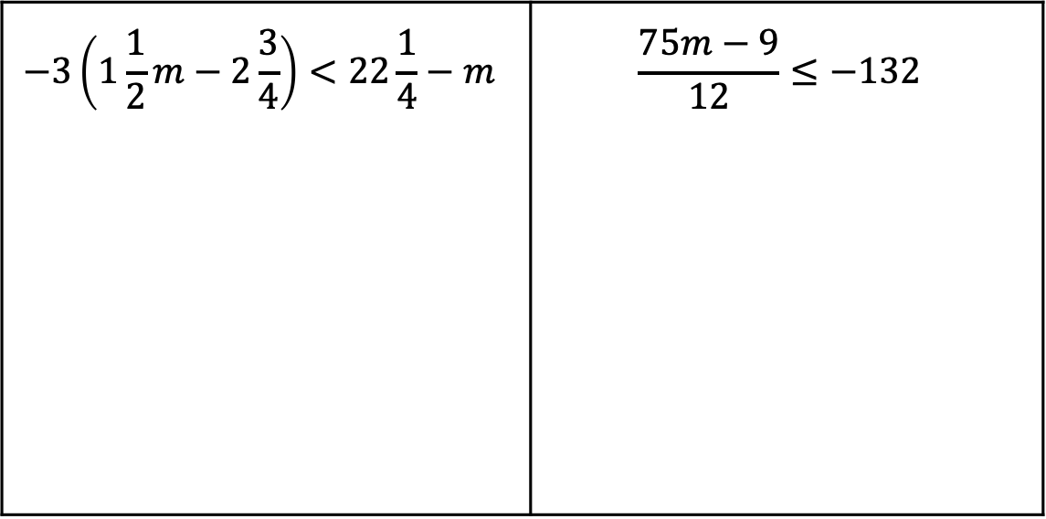
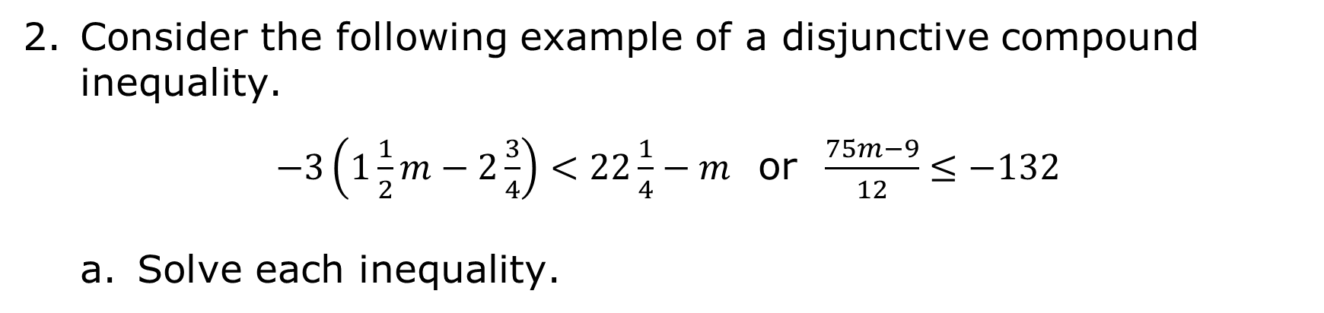
Consider the following example of a disjunctive compound inequality.
$−3\left(1\frac{1}{2}m−2\frac{3}{4}\right)<22\frac{1}{4}−m$ or $\frac{75m−9}{12}≤−132$
Solve each inequality.
$$−3\left(1\frac{1}{2}m−2\frac{3}{4}\right)<22\frac{1}{4}−m$$ | $$\frac{75m−9}{12}≤−132$$
volume 1, pg. 300

Slide 17
The solution set of the compound inequality is the set of all values that is a solution to either one of the inequalities. Graph the solution sets of both inequalities on the number line.
Explain which of the following values is not a solution to the compound inequality.
$−378$ $−5$ $19$
volume 1, pg. 300

Slide 18

Collaboration
volume 1, pg. 301

Slide 19

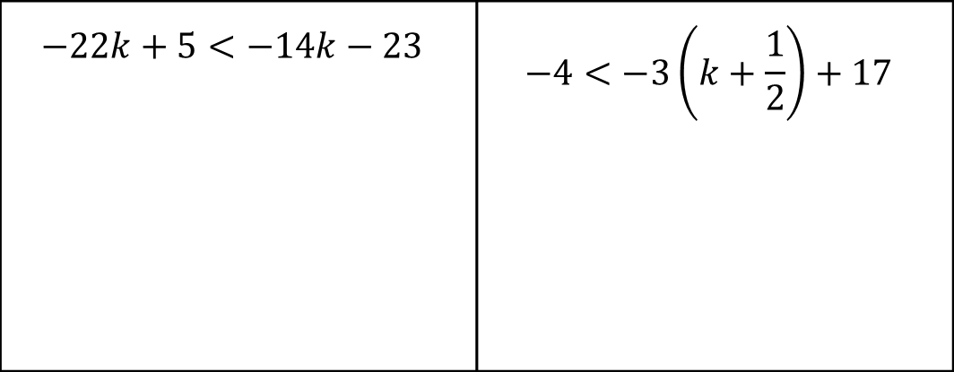
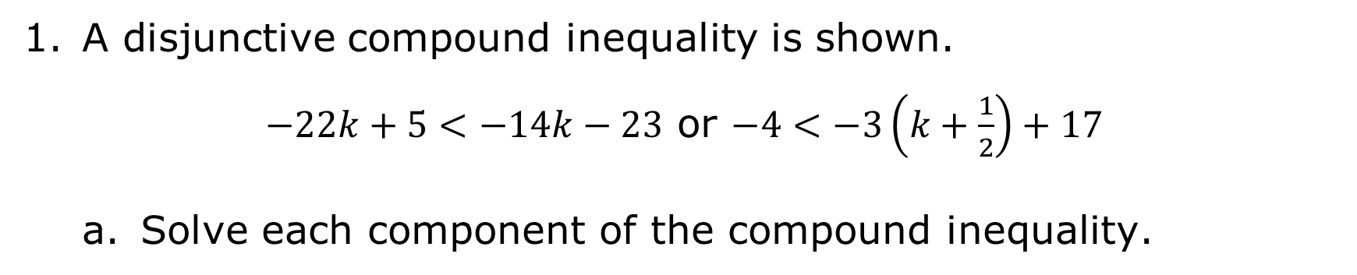
6.2.4 Collaboration: Special Cases in Compound Inequalities
A disjunctive compound inequality is shown.
$−22k+5<−14k−23$ or $−4<−3\left(k+\frac{1}{2}\right)+17$
Solve each component of the compound inequality.
$$−22k+5<−14k−23$$ | $$−4<−3\left(k+\frac{1}{2}\right)+17$$
volume 1, pg. 301

Slide 20

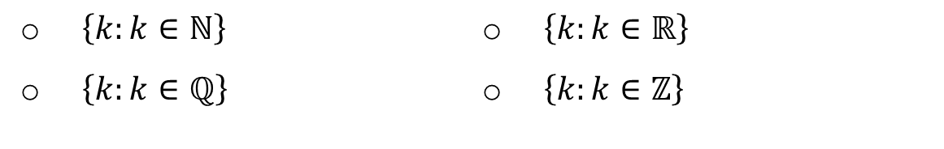
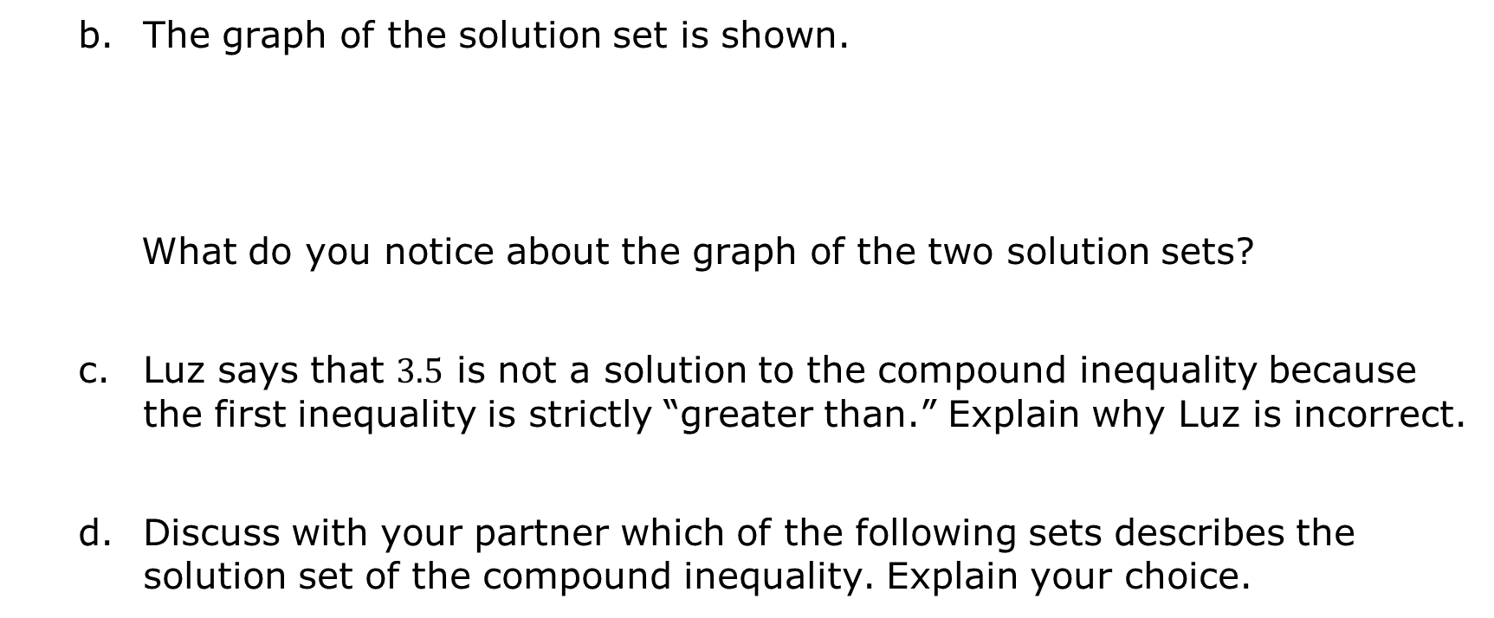
The graph of the solution set is shown.
What do you notice about the graph of the two solution sets?
Luz says that $3.5$ is not a solution to the compound inequality because the first inequality is strictly “greater than.” Explain why Luz is incorrect.
Discuss with your partner which of the following sets describes the solution set of the compound inequality. Explain your choice.
$\left\{k:k∈ℕ\right\}$
$\left\{k:k∈ℚ\right\}$
$\left\{k:k∈ℝ\right\}$
$\left\{k:k∈ℤ\right\}$
volume 1, pg. 301

Slide 21
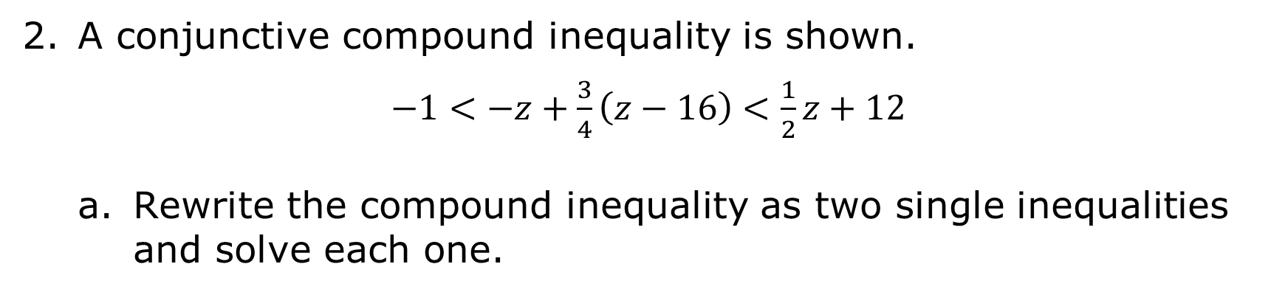
A conjunctive compound inequality is shown.
$−1<−z+\frac{3}{4}\left(z−16\right)<\frac{1}{2}z+12$
Rewrite the compound inequality as two single inequalities and solve each one.
volume 1, pg. 302

Slide 22
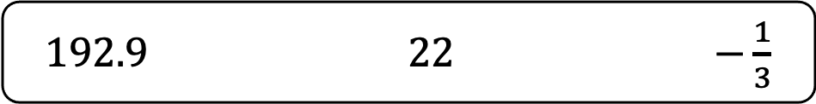
Explain whether any of the values shown satisfy both of the inequalities.
Describe the solution set of the compound inequality.
$192.9$ $22$ $−\frac{1}{3}$
A compound inequality could have no solutions, a finite set of solutions, or a solution of all real numbers.
volume 1, pg. 302

Slide 23

Guided Practice
volume 1, pg. 302

Slide 24

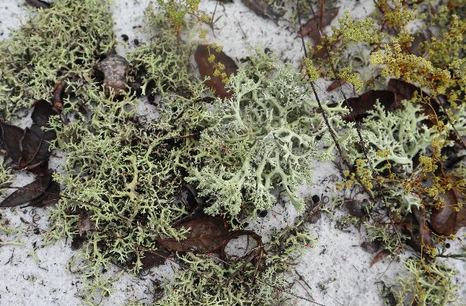
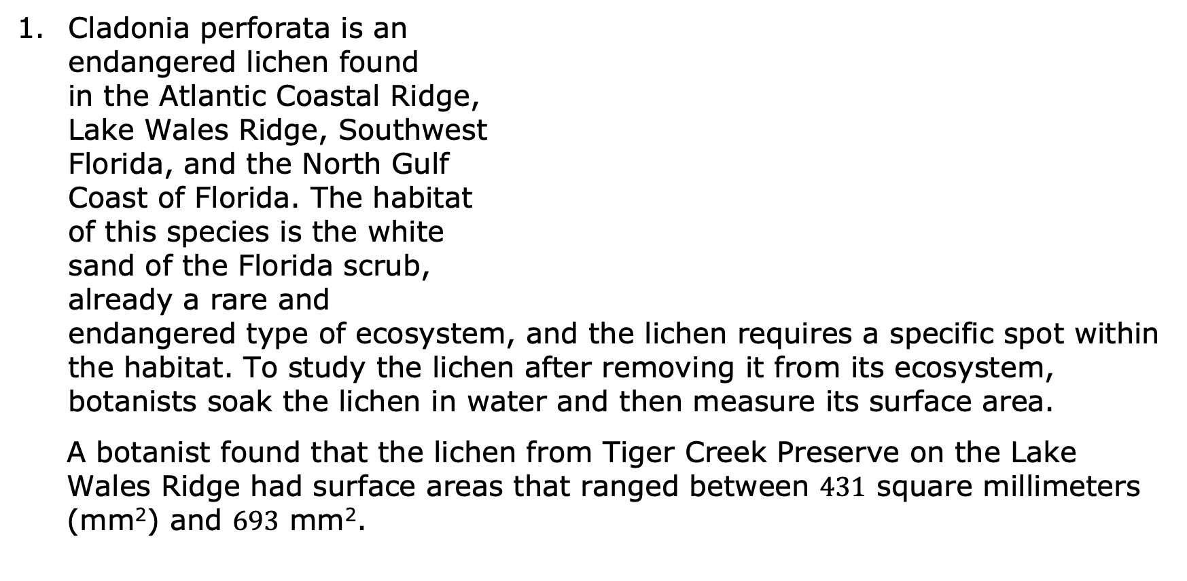
6.2.5 Guided Practice: Compound Inequalities in the Real World
Cladonia perforata is an endangered lichen found in the Atlantic Coastal Ridge, Lake Wales Ridge, Southwest Florida, and the North Gulf Coast of Florida. The habitat of this species is the white sand of the Florida scrub, already a rare and endangered type of ecosystem, and the lichen requires a specific spot within the habitat. To study the lichen after removing it from its ecosystem, botanists soak the lichen in water and then measure its surface area.
A botanist found that the lichen from Tiger Creek Preserve on the Lake Wales Ridge had surface areas that ranged between $431$ square millimeters (mm²) and $693$ mm².
volume 1, pg. 302

Slide 25
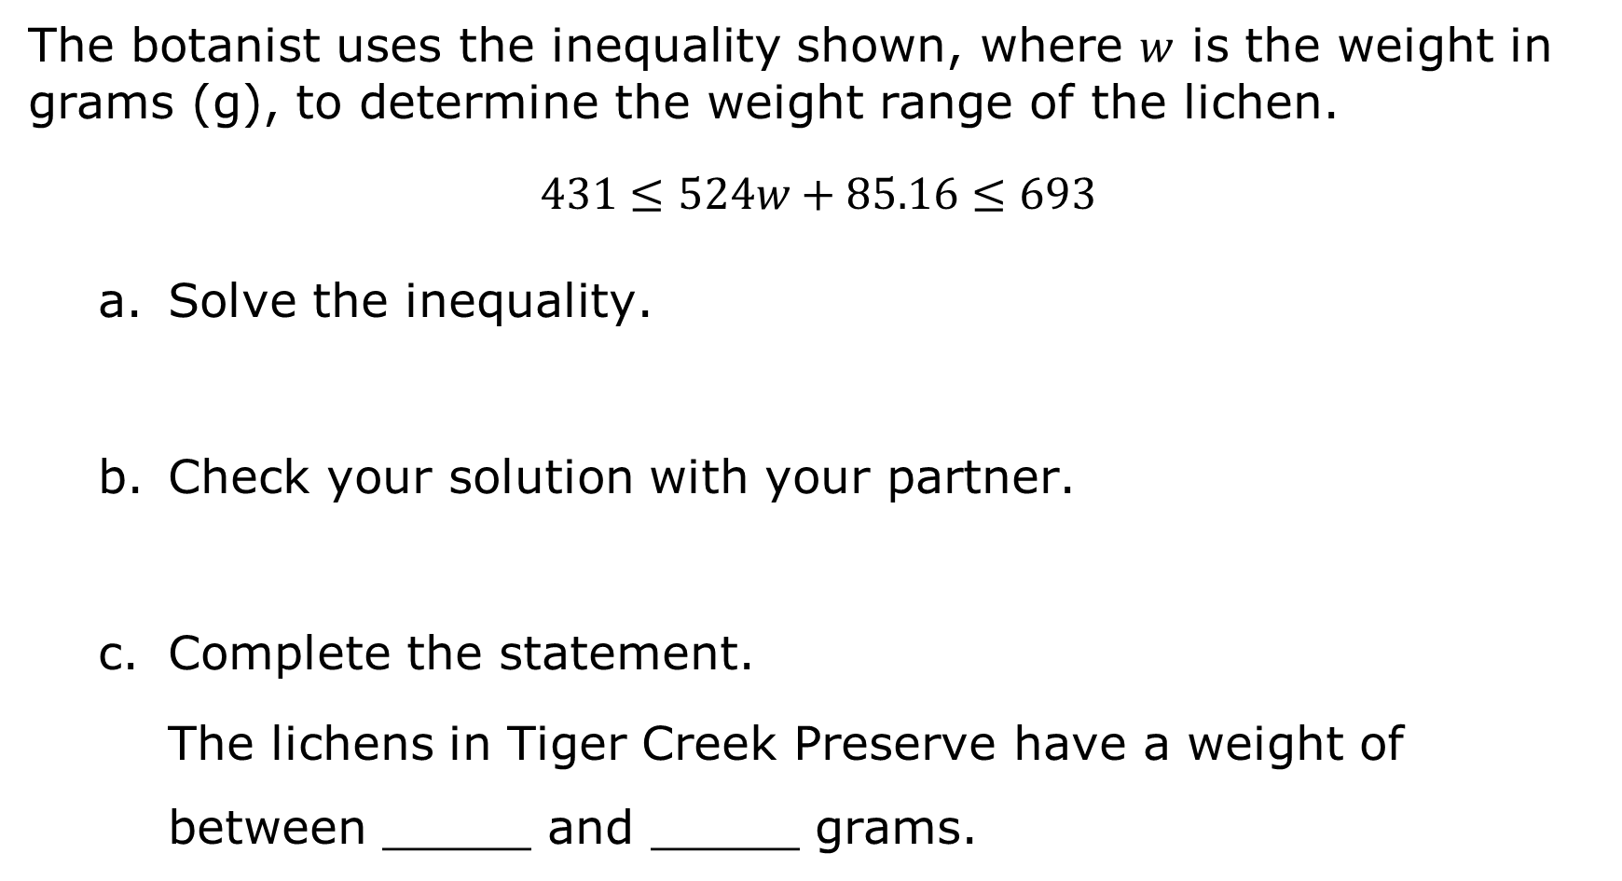
The botanist uses the inequality shown, where $w$ is the weight in grams (g), to determine the weight range of the lichen.
$$431≤524w+85.16≤693$$
Solve the inequality.
Check your solution with your partner.
Complete the statement.
The lichens in Tiger Creek Preserve have a weight of between _____ and _____ grams.
volume 1, pg. 302

Slide 26
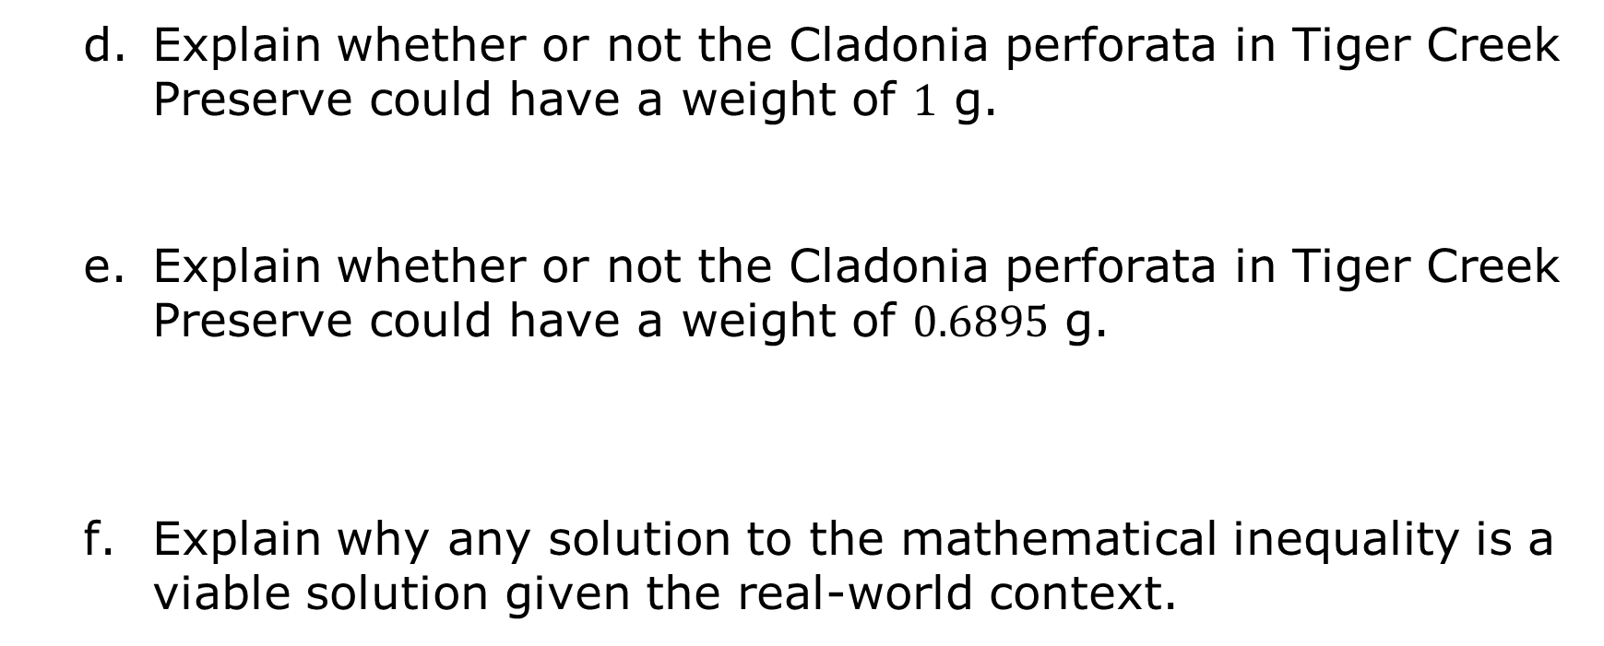
Explain whether or not the Cladonia perforata in Tiger Creek Preserve could have a weight of $1$ g.
Explain whether or not the Cladonia perforata in Tiger Creek Preserve could have a weight of $0.6895$ g.
Explain why any solution to the mathematical inequality is a viable solution given the real-world context.
volume 1, pg. 303

Slide 27

Your Turn
volume 1, pg. 303

Slide 28
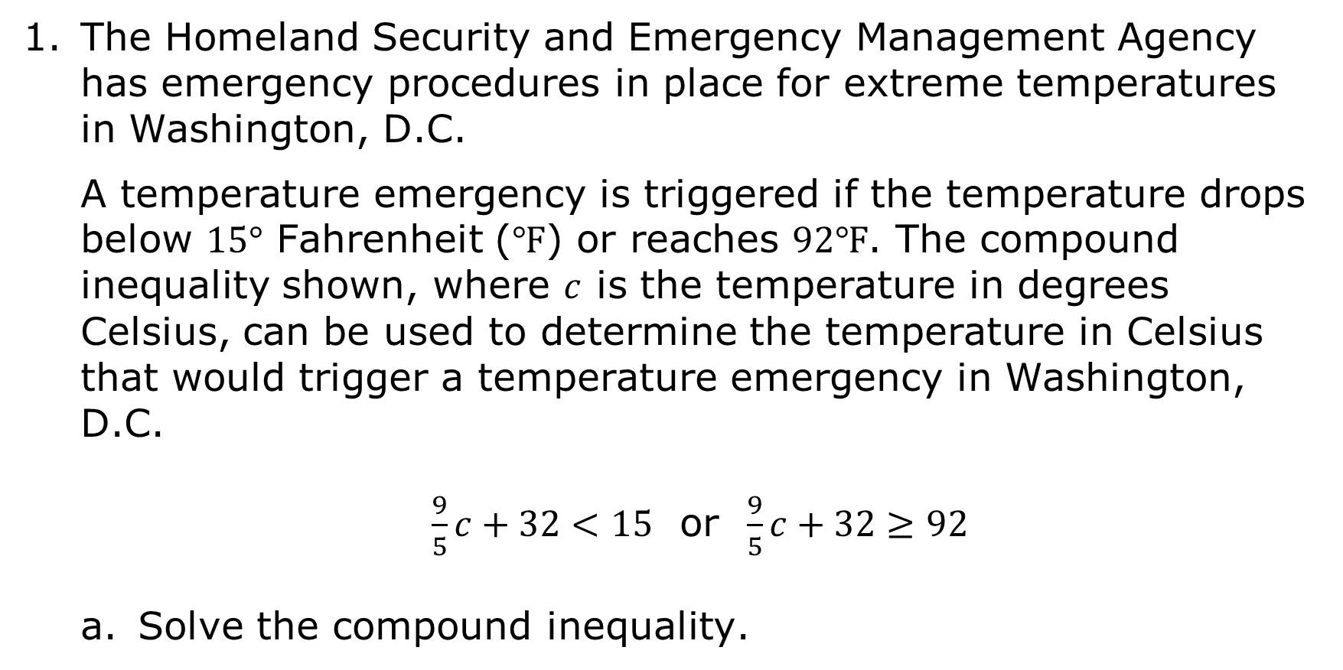
6.2.6 Your Turn!
The Homeland Security and Emergency Management Agency has emergency procedures in place for extreme temperatures in Washington, D.C.
A temperature emergency is triggered if the temperature drops below $15°$ Fahrenheit ($℉$) or reaches $92℉$. The compound inequality shown, where $c$ is the temperature in degrees Celsius, can be used to determine the temperature in Celsius that would trigger a temperature emergency in Washington, D.C.
$\frac{9}{5}c+32<15$ or $\frac{9}{5}c+32≥92$
Solve the compound inequality.
volume 1, pg. 303

Slide 29
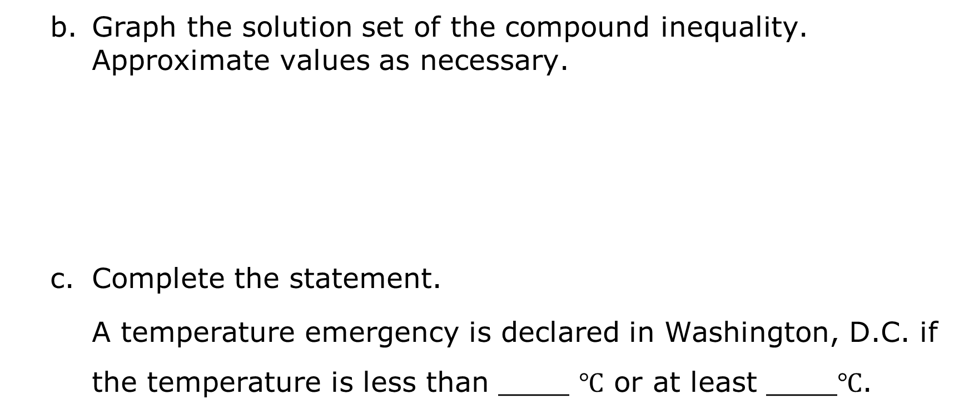
Graph the solution set of the compound inequality. Approximate values as necessary.
Complete the statement.
A temperature emergency is declared in Washington, D.C. if the temperature is less than ____ $℃$ or at least ____$℃$.
volume 1, pg. 303

Slide 30

Wrap-Up
volume 1, pg. 304

Slide 31
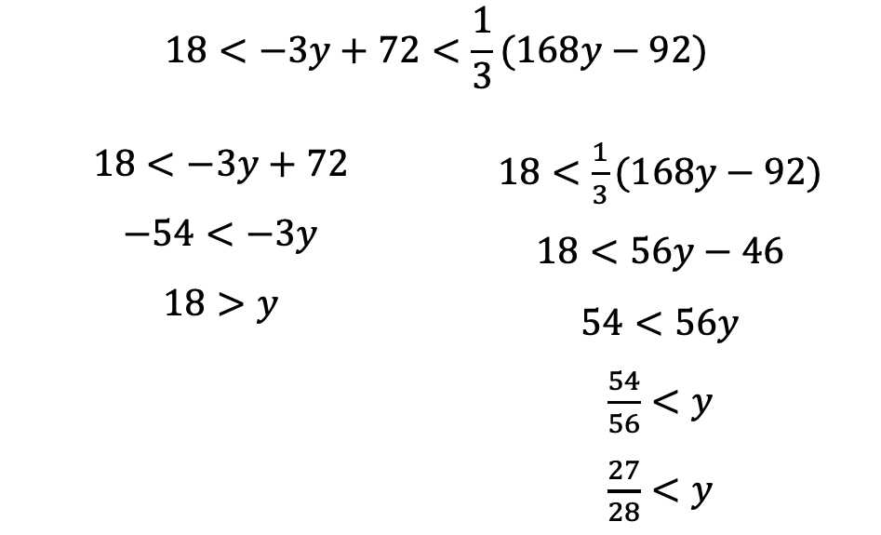

6.2.7 Wrap-Up: Error Analysis
Simeon solved a compound inequality. His work is shown.
Simeon stated the solution set is $\frac{27}{28}<y<18$. Explain the mistake(s) Simeon made.
$$18<−3y+72<\frac{1}{3}(168y−92)$$
$$18<−3y+72$$ $$−54<−3y$$ $$18>y$$ | $18<\frac{1}{3}(168y−92)$ $$18<56y−46$$ $$54<56y$$ $\frac{54}{56}<y$ $\frac{27}{28}<y$
volume 1, pg. 304

